Slide 1
End Project Capstone
By Jan Barnhoorn

Slide 2
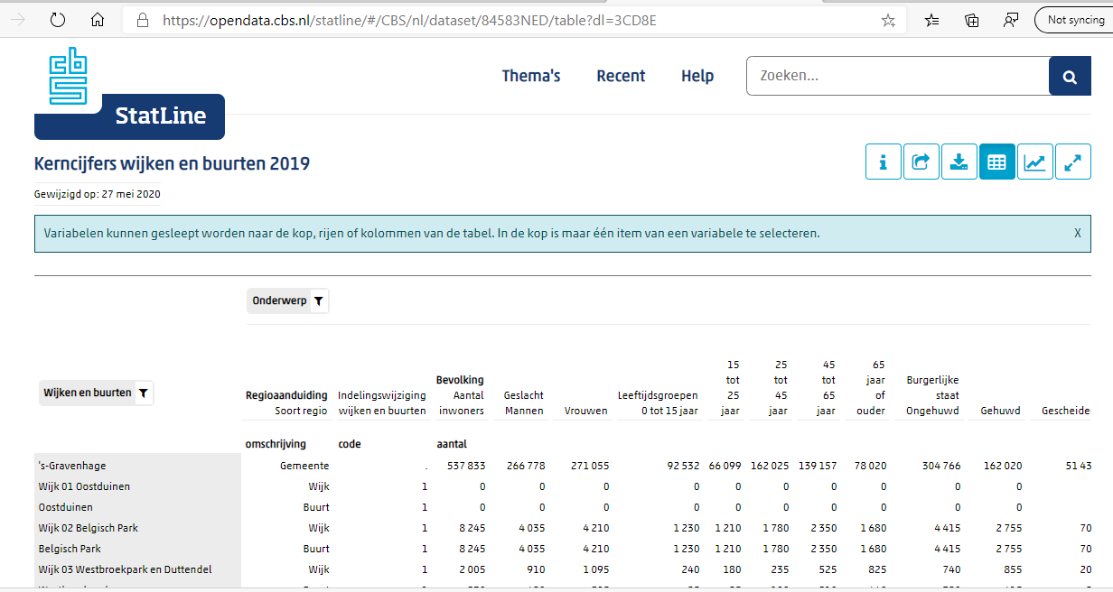
Data sources

Slide 3
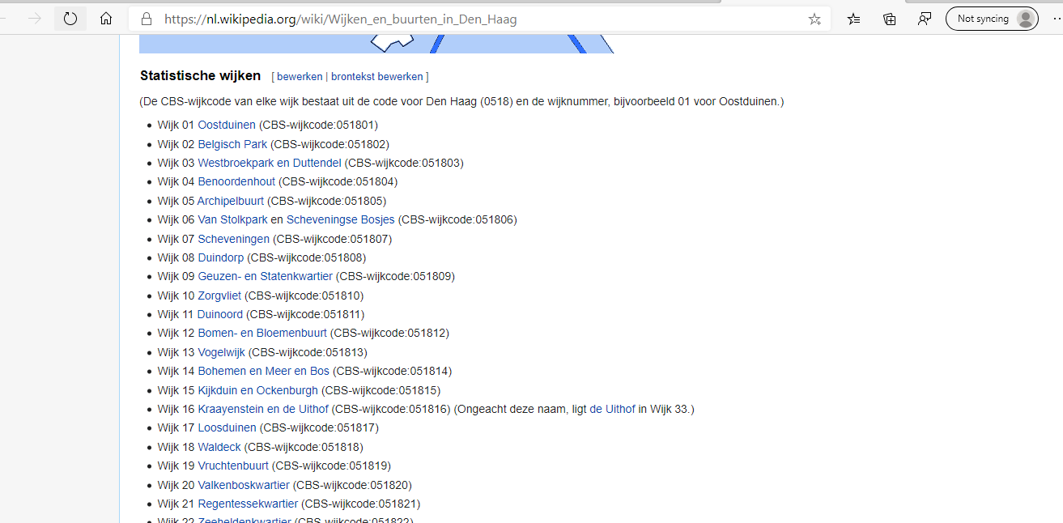
Data sources

Slide 4
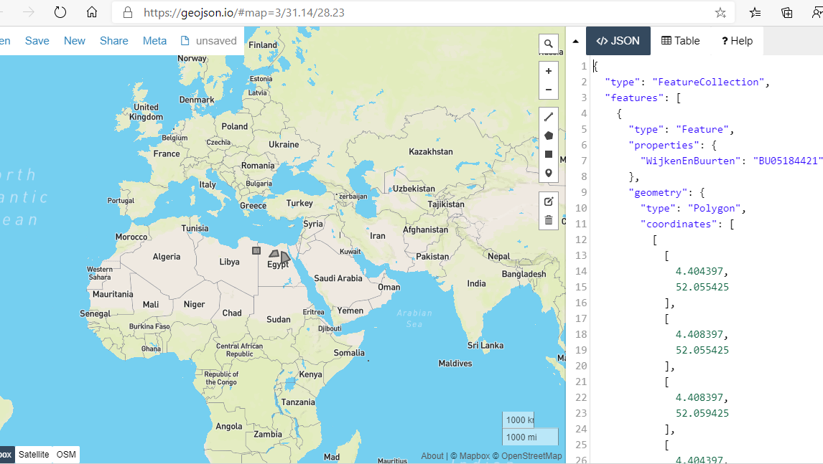
Data sources

Slide 5
Data cleansing
Using R code
Drop tables from CBR
Add Buurten namen
Get coordinates
Make a JSON file
Filter on The Hague

Slide 6
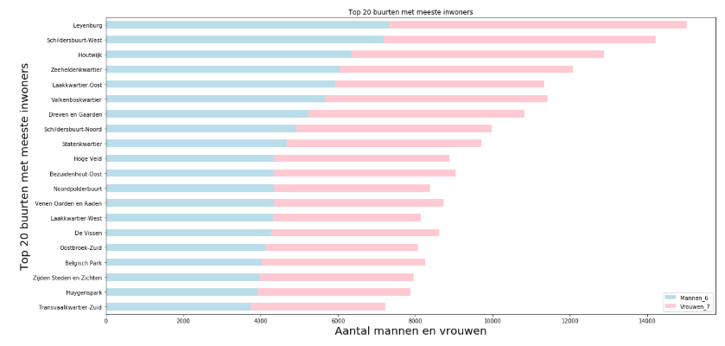
Data analyses

Slide 7
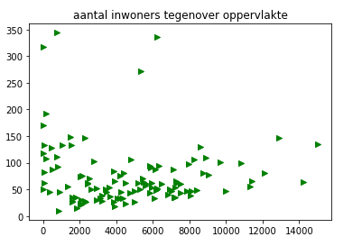
Data analyses

Slide 8
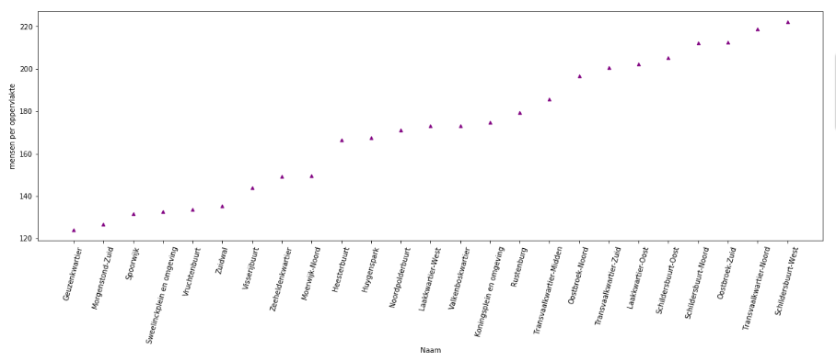
Data analyses

Slide 9
Data analyses

Slide 10
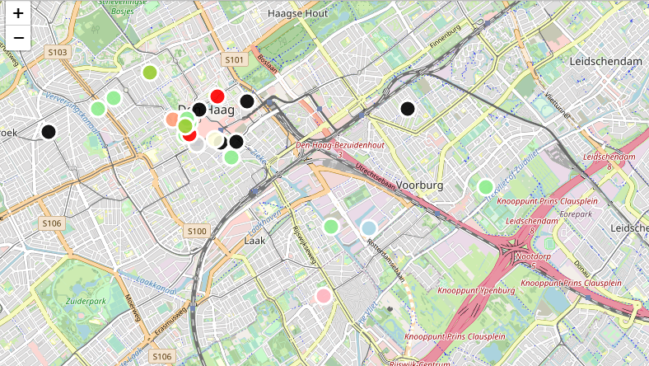
Exploring surroudings

Slide 11
Exploring surroudings
Fratelli, located in the neighboorhoof “Voorhout”: https://www.fratelli.nl/den-haag/
Giuliano’s, located in the neighboorhood “Zeeheldenkwartier“ : http://giulianos.nl/

Slide 12
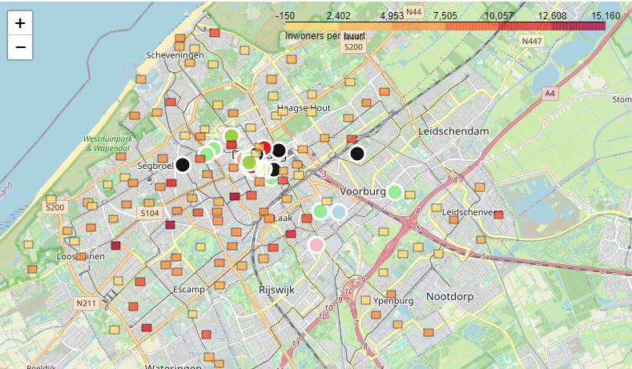
Exploring surroudings

Slide 13
conclusion
The most inhabitated neughboorhoods are the following 10:
Leyenburg,
Schilderbuurt-West ,
Houtwijk,
Zeeheldenkwartier,
Laakkwartier- Oost,
Valkenboskwartier,
Dreven en Gaarden,
Schilderbuurt- Noord,
Statenkwartier,
Hoge Veld.
Based on the density per m2 the most interresting neighboorhoods are:
Schilderbuurt-West,
Transvaalkwartier-Noort,
Oostbroek-Zuid,
Schilderbuurt-Noord,
Schilderbuurt-Oost,
Laakkwartier-Oost,
Transvaalkwartier-Zuid,
Oostbroek-Noord,
Transvaalkwartier,
Rustenburg.

Slide 14
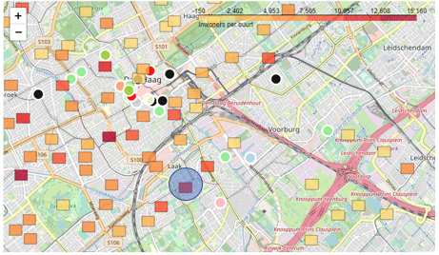
Recommendation
Laakkwartier

